Slide 1
Arc of DEI WORKSHOPPING: Forming the FOUNDATION of DEI WORK
Point 1: ESSENTIAL TOOLS for DEI Work
Working AGREEMENTS (creating brave space/fundamental for resilience)
CHECK-IN (establishing human connection/fundamental for resilience)
Working DEFINITIONS (common: language/knowledge/understanding/starting place)
Point 2: RESILIENCE (individual & group; human brain/neurology & culture)
CORE IDENTITY: deeply held; constructively immutable; anything that might touch = potential threat
AFFINITY: lived experience; empathy; connection; joy; pleasure; implicit association/unconscious bias
TRAUMA INFORMED: managing trauma, silhouettes - individual, generational; destabilizing; avoiding pain
Point 3: ELEMENTAL PRACTICE (experiential education; growth – holding lessons learned – from failure & success)
REQUIRES WORK: individual, group/organizational, & eventually systemic; adapting from lessons learned
EFFICIENT DISCOMFORT: candor; vulnerability; challenge; obstacle; opposition; tension; disturbance; conflict
USE YOUR RESOURCES (HUMAN/NATURAL): lived experience; empathy; kinship; leadership; allyship; partnership; followership; interconnection; inner connection; trust; celebration

Slide 2
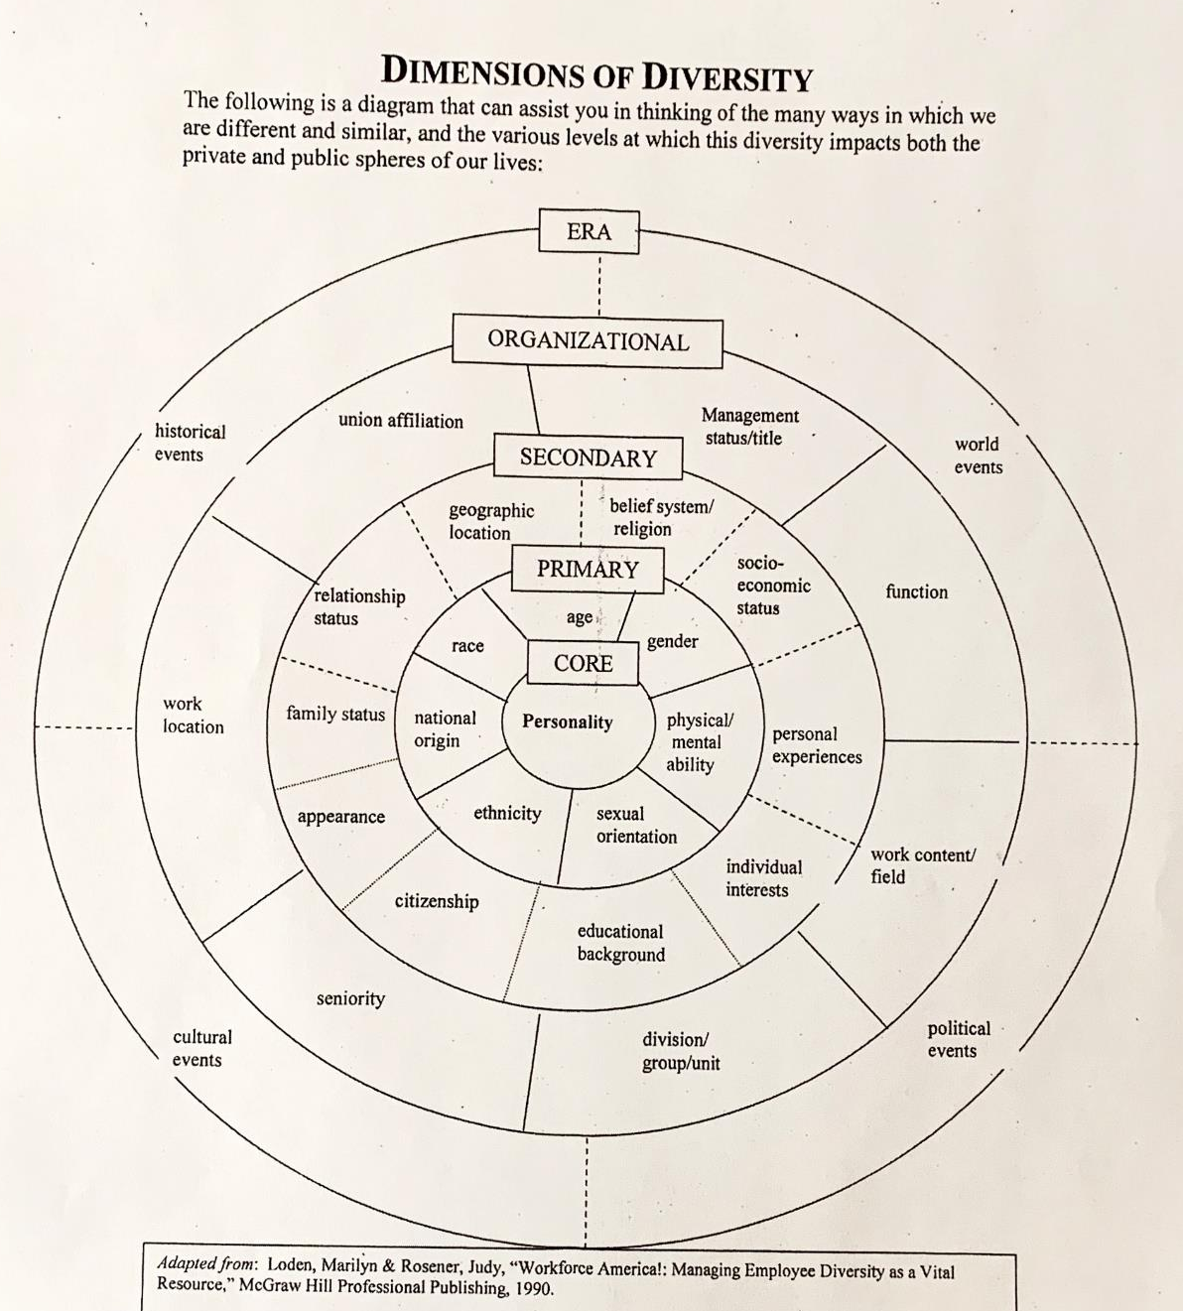

Slide 3
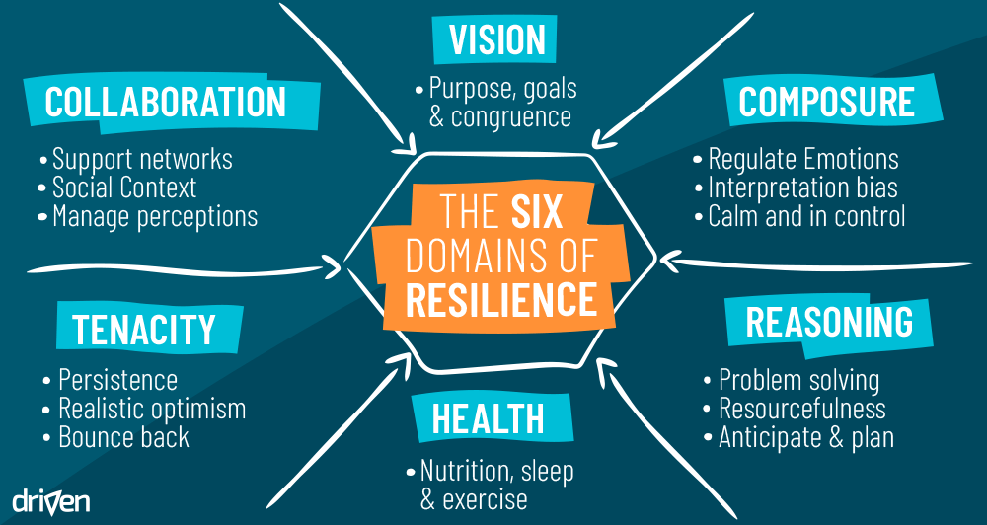

Slide 4
WORKING AGREEMENTS [PRACTITIONERS CIRCLE SAMPLE]
To create and sustain brave space for all of us to freely question anything and bring our utmost candor as we explore our lived experiences with diversity, equity, and inclusion, we call ourselves into this practice circle, at a waypoint in our learning journey, and here we share our working agreements:
Enter fully present; listen actively; speak for yourself.
Honor passion and compassion.
Whatever way communicated, language used, we support positive intent, tend to impact.
Explore difference, conflict, tension, mistake, error, failure, imperfection, discomfort & success, as sources of learning and growth.
Care for yourself yet commit to ego check.
Anyone may call a pause or pull the emergency brake.
Celebrate and savor commonalities and differences.
Stories stay, learnings go.

Slide 5
Arc of DEI WORKSHOPPING: Forming the FOUNDATION of DEI WORK
Point 1: ESSENTIAL TOOLS for DEI Work
Working AGREEMENTS (creating brave space/fundamental for resilience)
CHECK-IN (establishing human connection/fundamental for resilience)
Working DEFINITIONS (common: language/knowledge/understanding/starting place)
Point 2: RESILIENCE (individual & group; human brain/neurology & culture)
CORE IDENTITY: deeply held; constructively immutable; anything that might touch = potential threat
AFFINITY: lived experience; empathy; connection; joy; pleasure; implicit association/unconscious bias
TRAUMA INFORMED: managing trauma, silhouettes - individual, generational; destabilizing; avoiding pain
Point 3: ELEMENTAL PRACTICE (experiential education; growth – holding lessons learned – from failure & success)
REQUIRES WORK: individual, group/organizational, & eventually systemic; adapting from lessons learned
EFFICIENT DISCOMFORT: candor; vulnerability; challenge; obstacle; opposition; tension; disturbance; conflict
USE YOUR RESOURCES (HUMAN/NATURAL): lived experience; empathy; kinship; leadership; allyship; partnership; followership; interconnection; inner connection; trust; celebration

Slide 6
Working the WORKING DEFINITIONS
Threshold: acknowledgement of meanings operating in discourse between folks, in any combo, in community
Threshold: understanding of meanings operating in discourse between folks, in any combo, in community
Threshold: agreement with common elements; elements that vary are understood by all
Threshold: consensus agreement on sprawling, multi-faceted definition
Threshold: consensus on concise singular definition
Whatever THRESHOLD of meaning, whatever the definitions of our words
At the outset of DEIJ work:
Share your definitions
Everyone knows what the collection of meaning is for your working group

Slide 7
CHARACTERISTICS of TU DOMINANT CULTURE
THE ONLY REAL ANGLING IS FLY FISHING
CATCH & RELEASE SIGNALS VIRTUE
MEET US WHERE WE ARE
IT'S ALL ABOUT FLY FISHING
GEAR IS KING*
MEN’S CLUB*
*AND DON’T THE BOYS BE BRAGGIN’!
FLY FISHING RULES, EVERTHING ELSE (COLDWATER CONSERVATION) COMES AFTER
FLY FISHING? OF COURSE! THEN WHERE DO YOU FISH?
THE FISH DON’T CARE (HOW WE FISH), BUT WE SURE DO
LET ME SHOW YOU HOW TO DO IT THE CORRECT WAY
DEI (CRAP) IS NOT WHAT WE DO
SENIORITY RULES
JUST WANT MY OL’ CLUB
EVEN WHEN WE ARE BEING INCLUSIVE, WE ARE FAR LESS INCLUSIVE THAN WE THINK WE ARE

Slide 8
Arc of DEI WORKSHOPPING: Forming the FOUNDATION of DEI WORK
Point 1: ESSENTIAL TOOLS for DEI Work
Working AGREEMENTS (creating brave space/fundamental for resilience)
CHECK-IN (establishing human connection/fundamental for resilience)
Working DEFINITIONS (common: language/knowledge/understanding/starting place)
Point 2: RESILIENCE (individual & group; human brain/neurology & culture)
CORE IDENTITY: deeply held; constructively immutable; anything that might touch = potential threat
AFFINITY: lived experience; empathy; connection; joy; pleasure; implicit association/unconscious bias
TRAUMA INFORMED: managing trauma, silhouettes - individual, generational; destabilizing; avoiding pain
Point 3: ELEMENTAL PRACTICE (experiential education; growth – holding lessons learned – from failure & success)
REQUIRES WORK: individual, group/organizational, & eventually systemic; adapting from lessons learned
EFFICIENT DISCOMFORT: candor; vulnerability; challenge; obstacle; opposition; tension; disturbance; conflict
USE YOUR RESOURCES (HUMAN/NATURAL): lived experience; empathy; kinship; leadership; allyship; partnership; followership; interconnection; inner connection; trust; celebration

