Slide 1
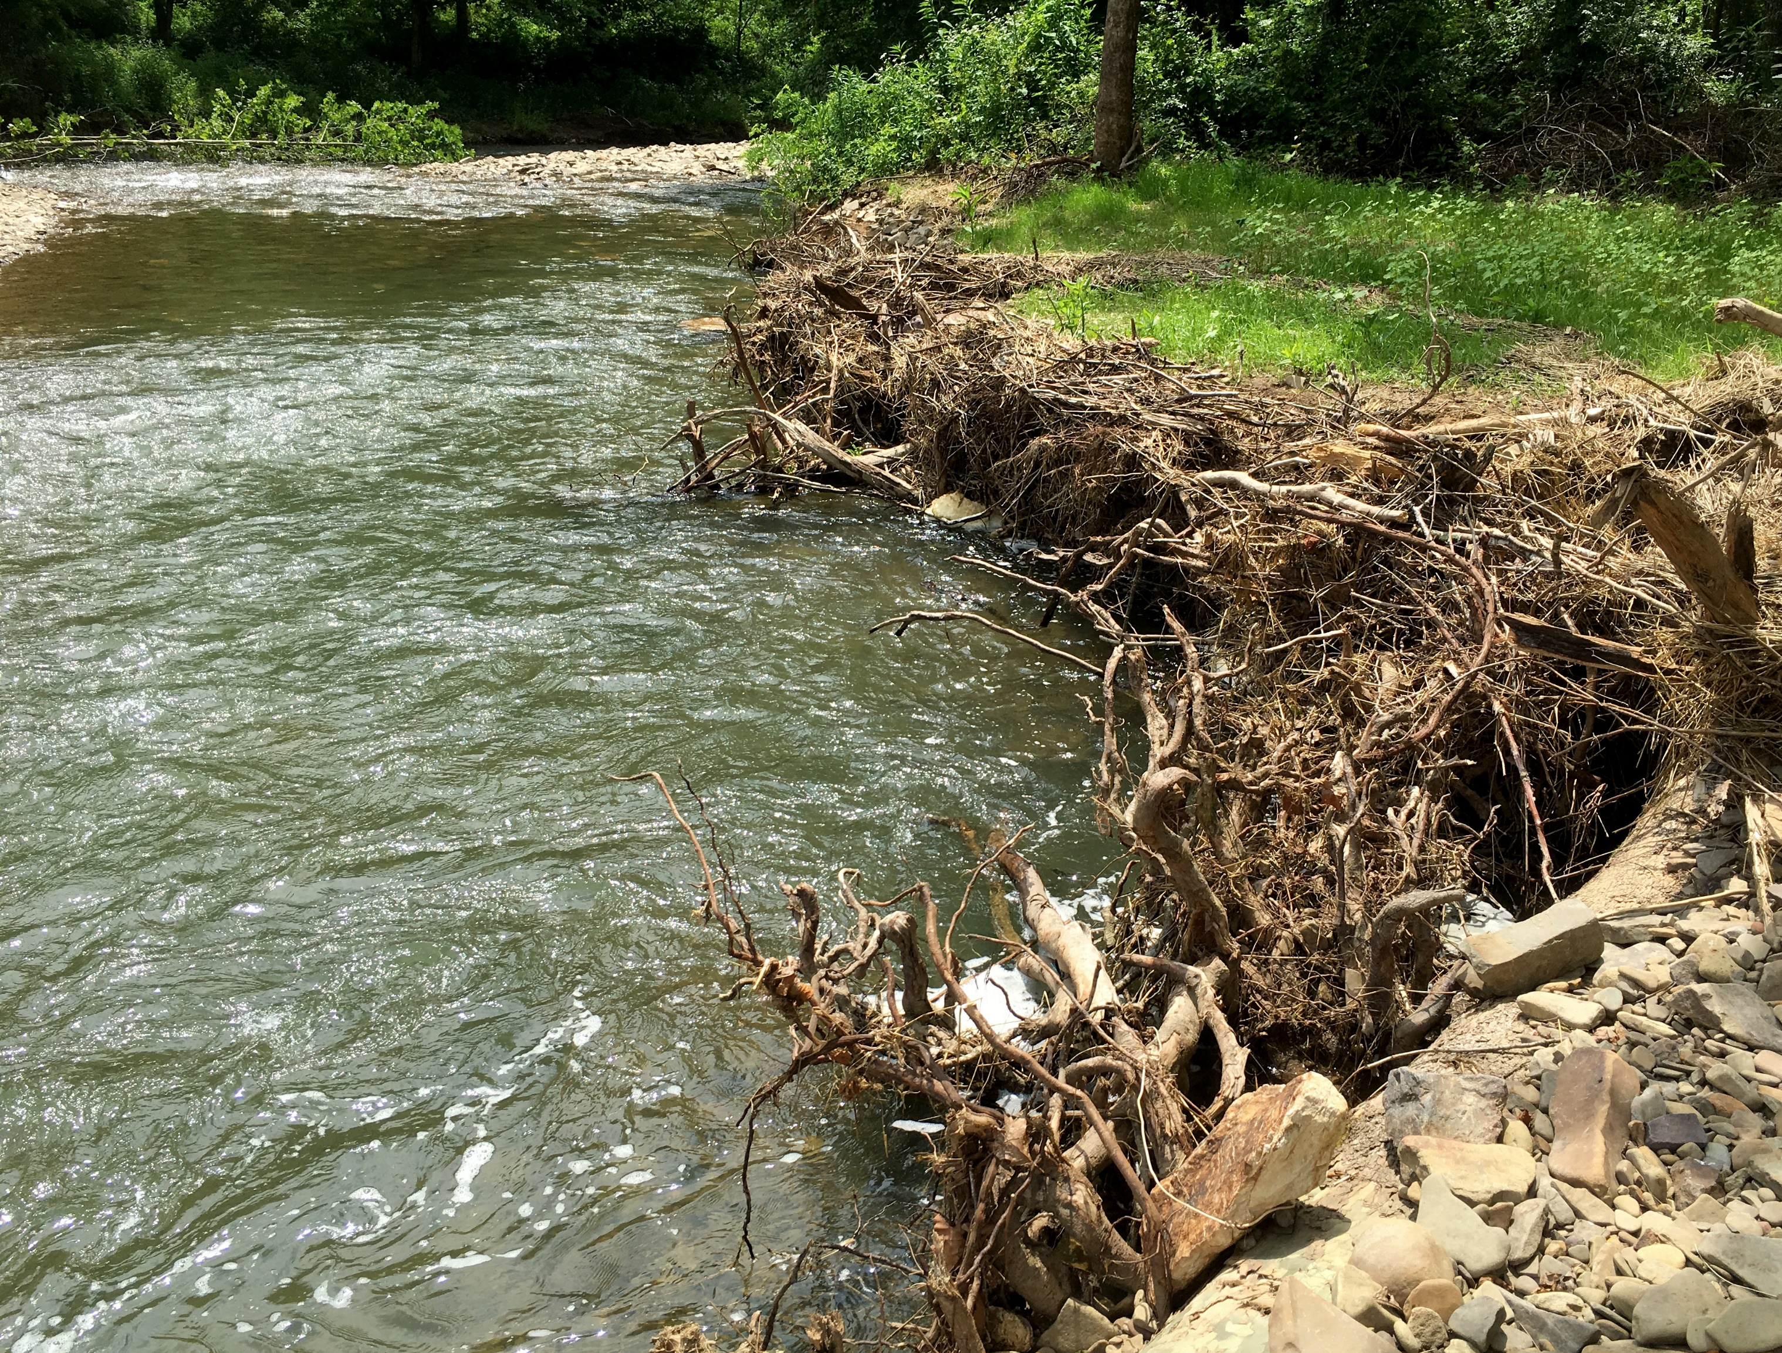
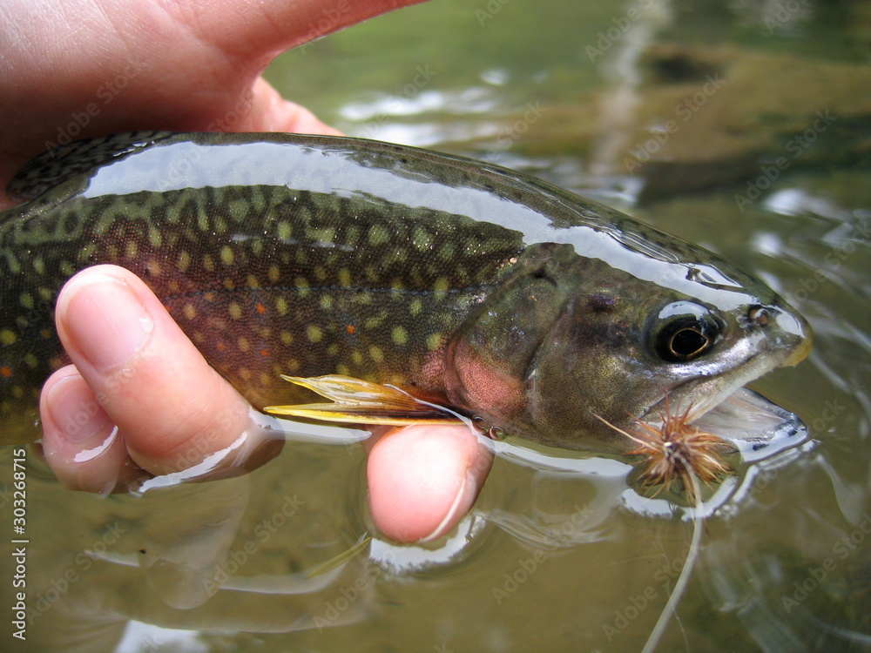
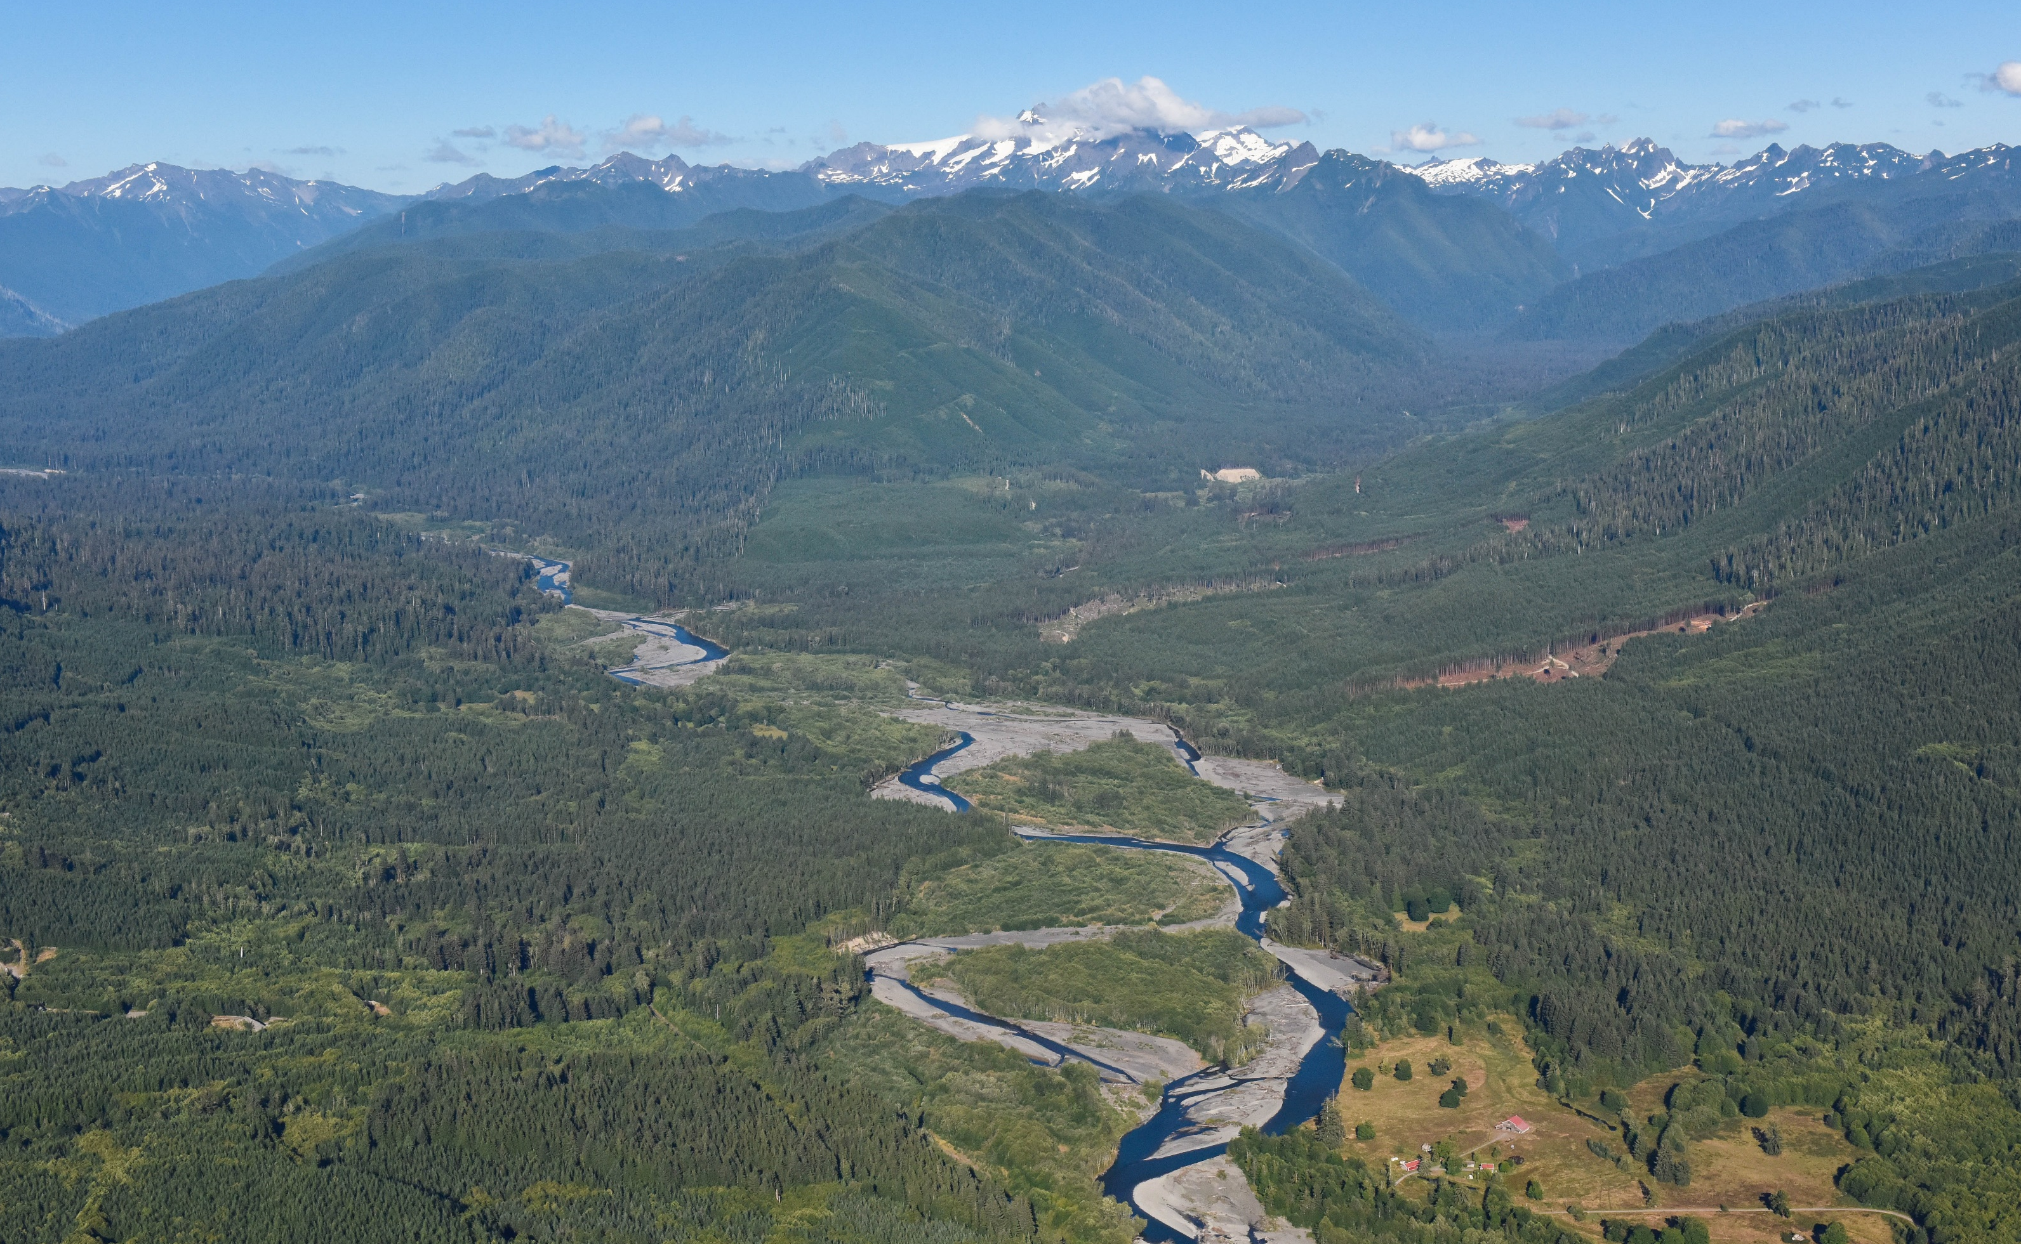
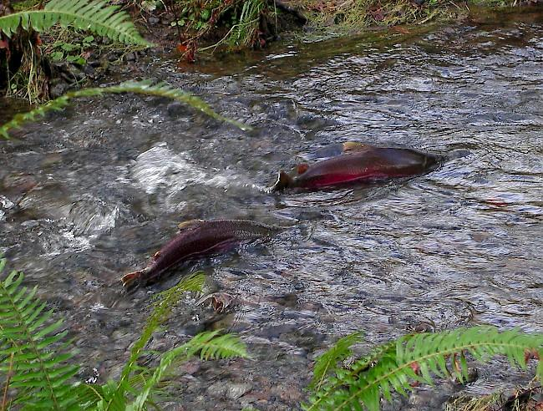

HEALTHY FISH RELY ON
HEALTHY WATER.
WE ALL DO.
Thank you for being a volunteer.
TU New Leader Orientation January 2025

Slide 2
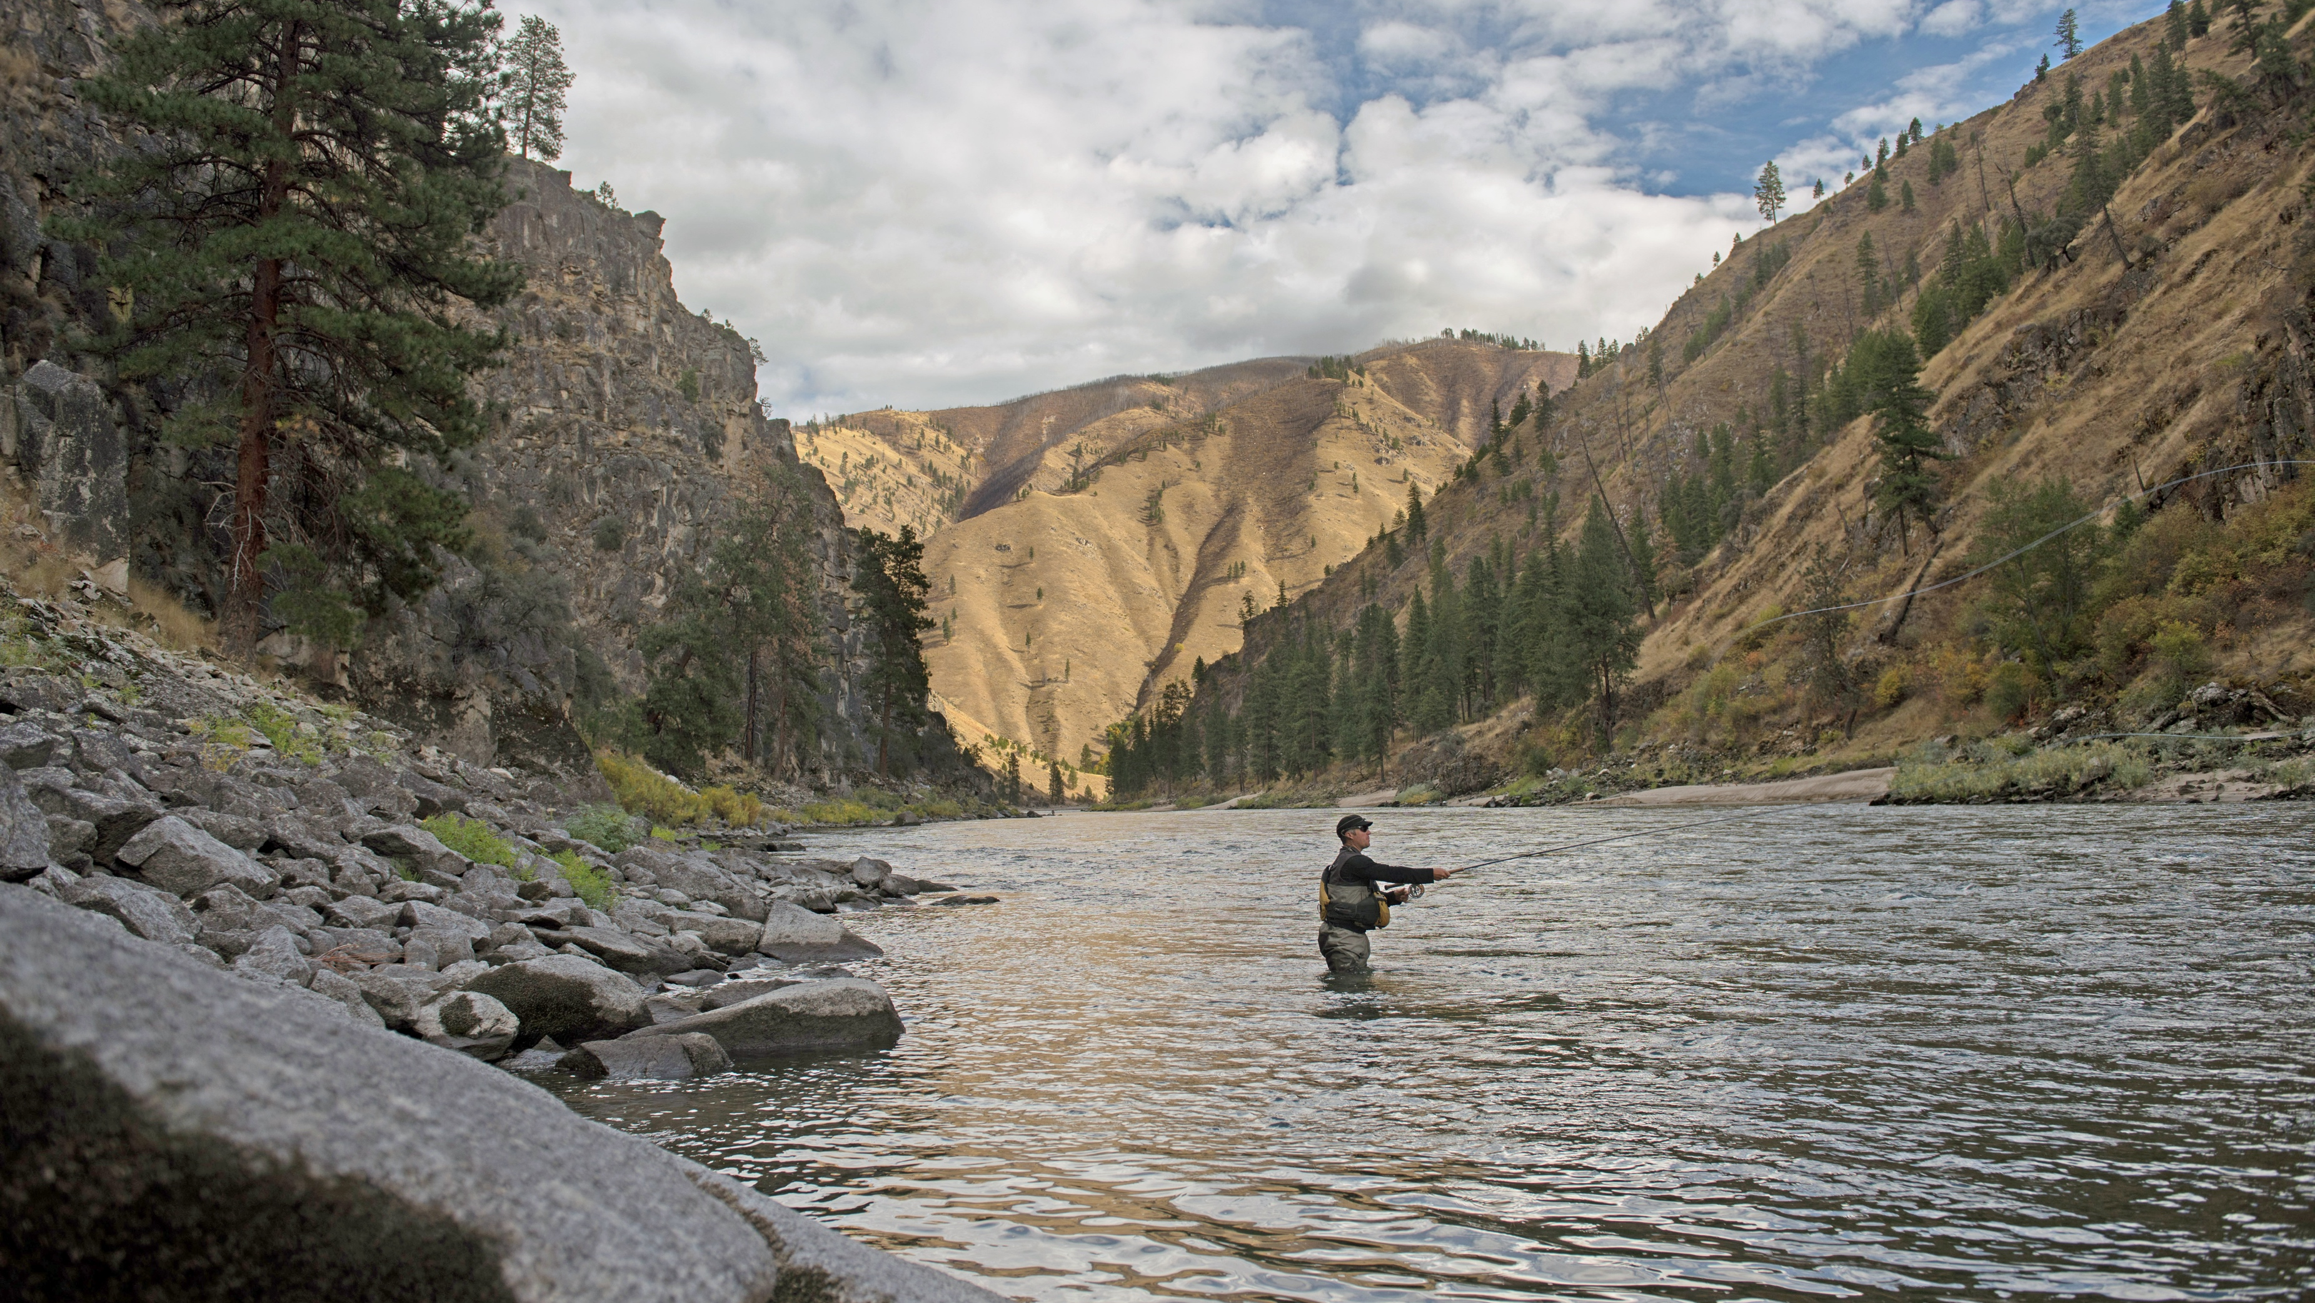
TROUT UNLIMITED’S MISSION is to bring together diverse interests to care for and recover rivers and streams so our children can experience the joy of wild and native trout and salmon.
TU has 350,000+ members and supporters nationwide and 400+ councils and chapters in 44 states.
Salmon River, Idaho

Slide 3
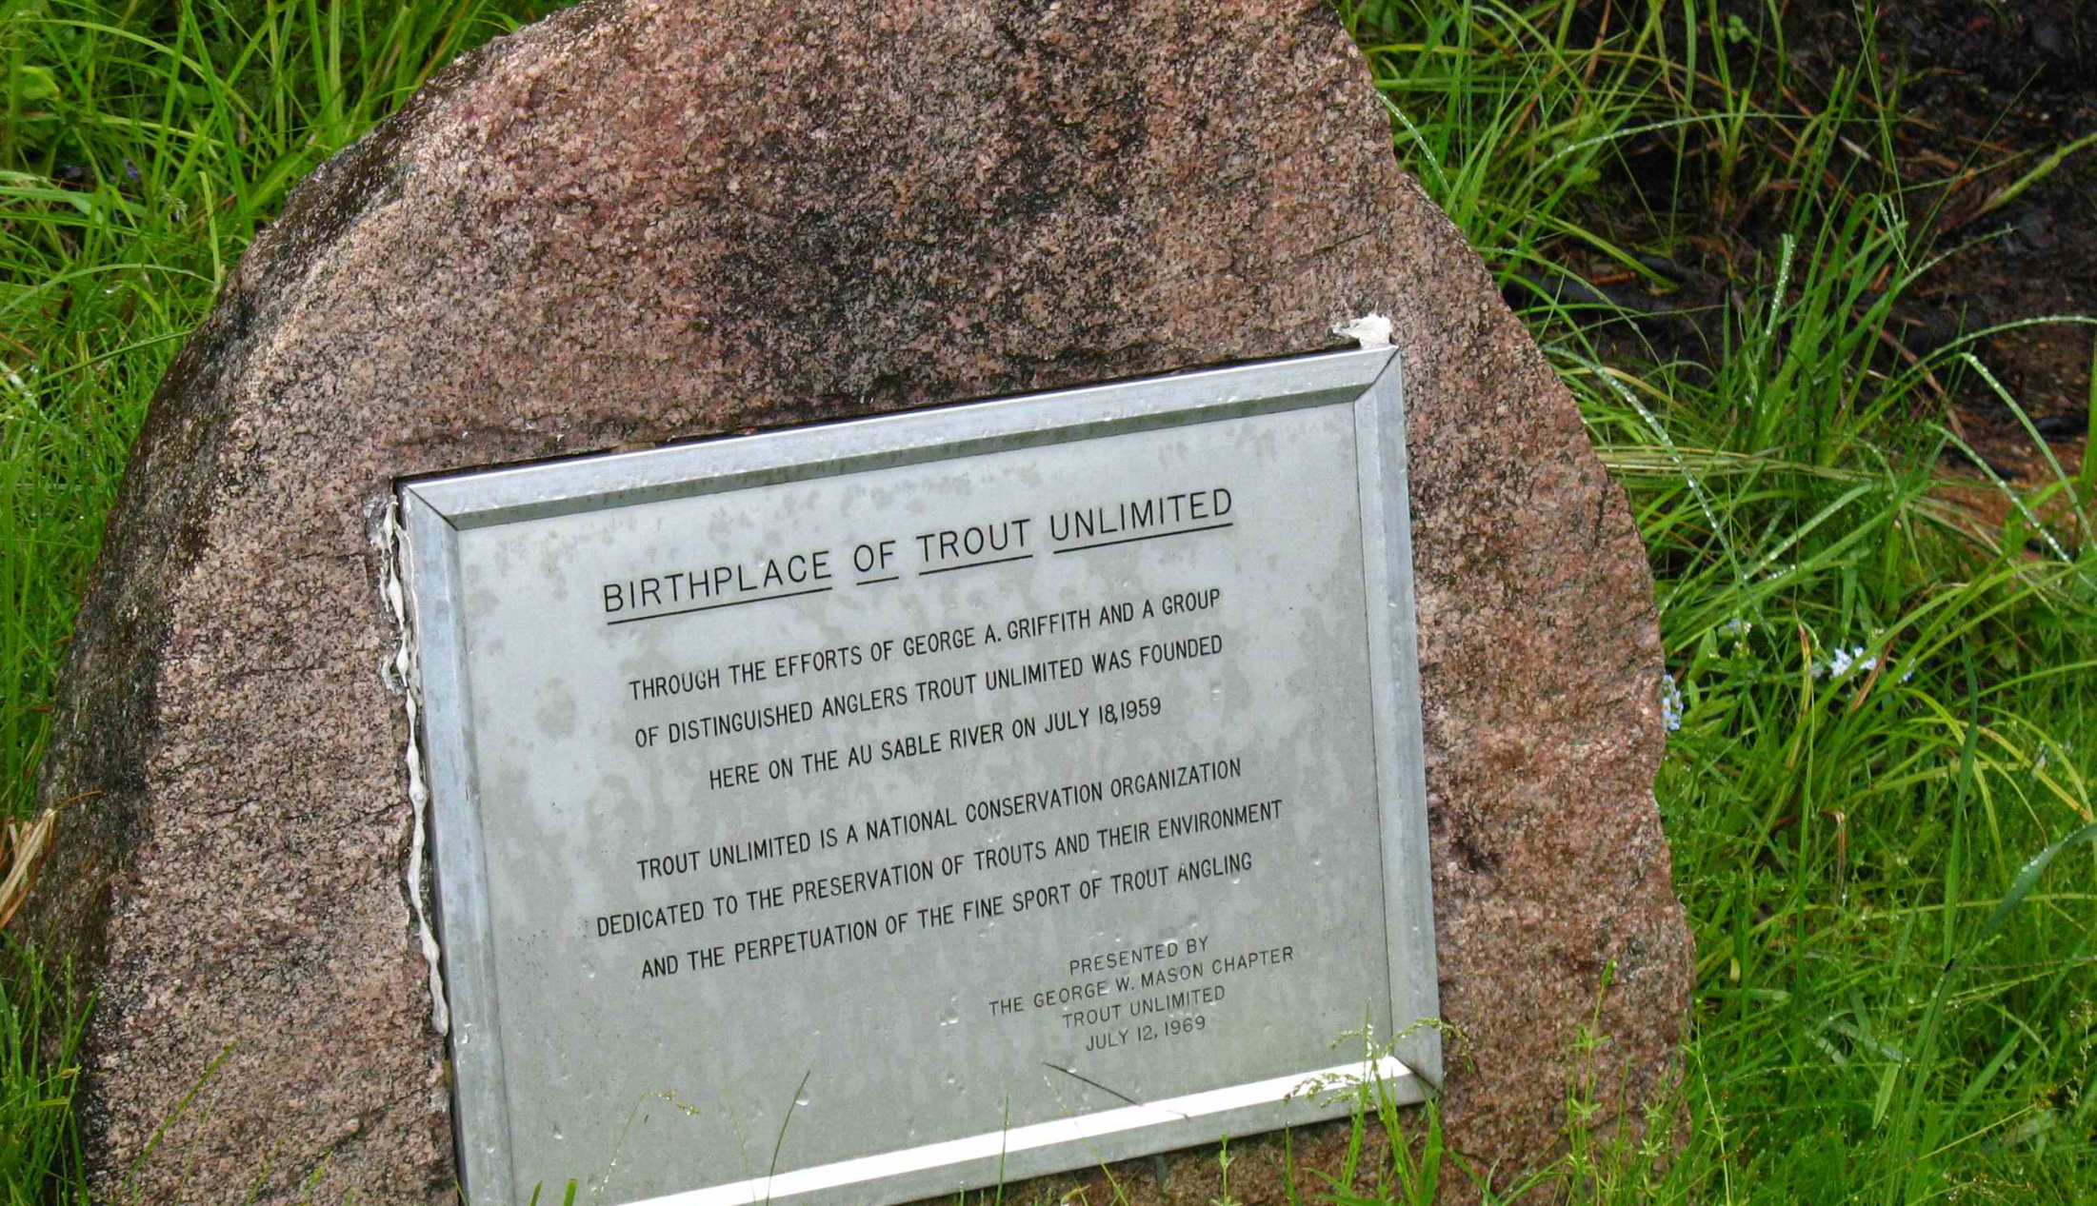
Trout Unlimited’s History
TU was founded in 1959 in Michigan
Built on a volunteer chapter structure
Chapters run their own operations independent of National operations
National operations did not go much beyond creating and distributing TROUT magazine until 1992
$2 million operating budget and 55,000 members in 1992

Slide 4
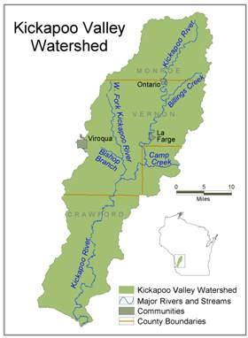
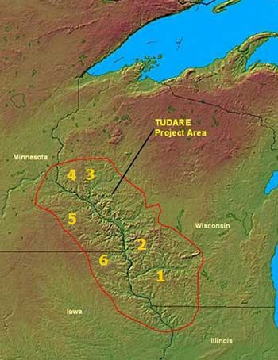
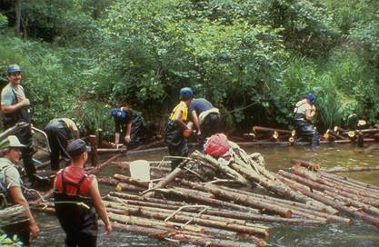
Trout Unlimited’s Evolution
Pre-1990’s: Local, in-stream projects
1990’s:Full watershed scale projects
21st Century: Species or regional scale projects

Slide 5
TU's New Strategic Plan Goals
1. Identify a national network of shared priority waters for native and wild trout and salmon and take strategic action to care for and recover them.
2. Inspire a diverse corps of staff, volunteers, and partners to advocate for and participate in the care and recovery of our lands and waters.
3. Invest in systems and people—staff, volunteers, and partners—so we have the tools, technology, training, and resources necessary to achieve our shared goals.

Slide 6
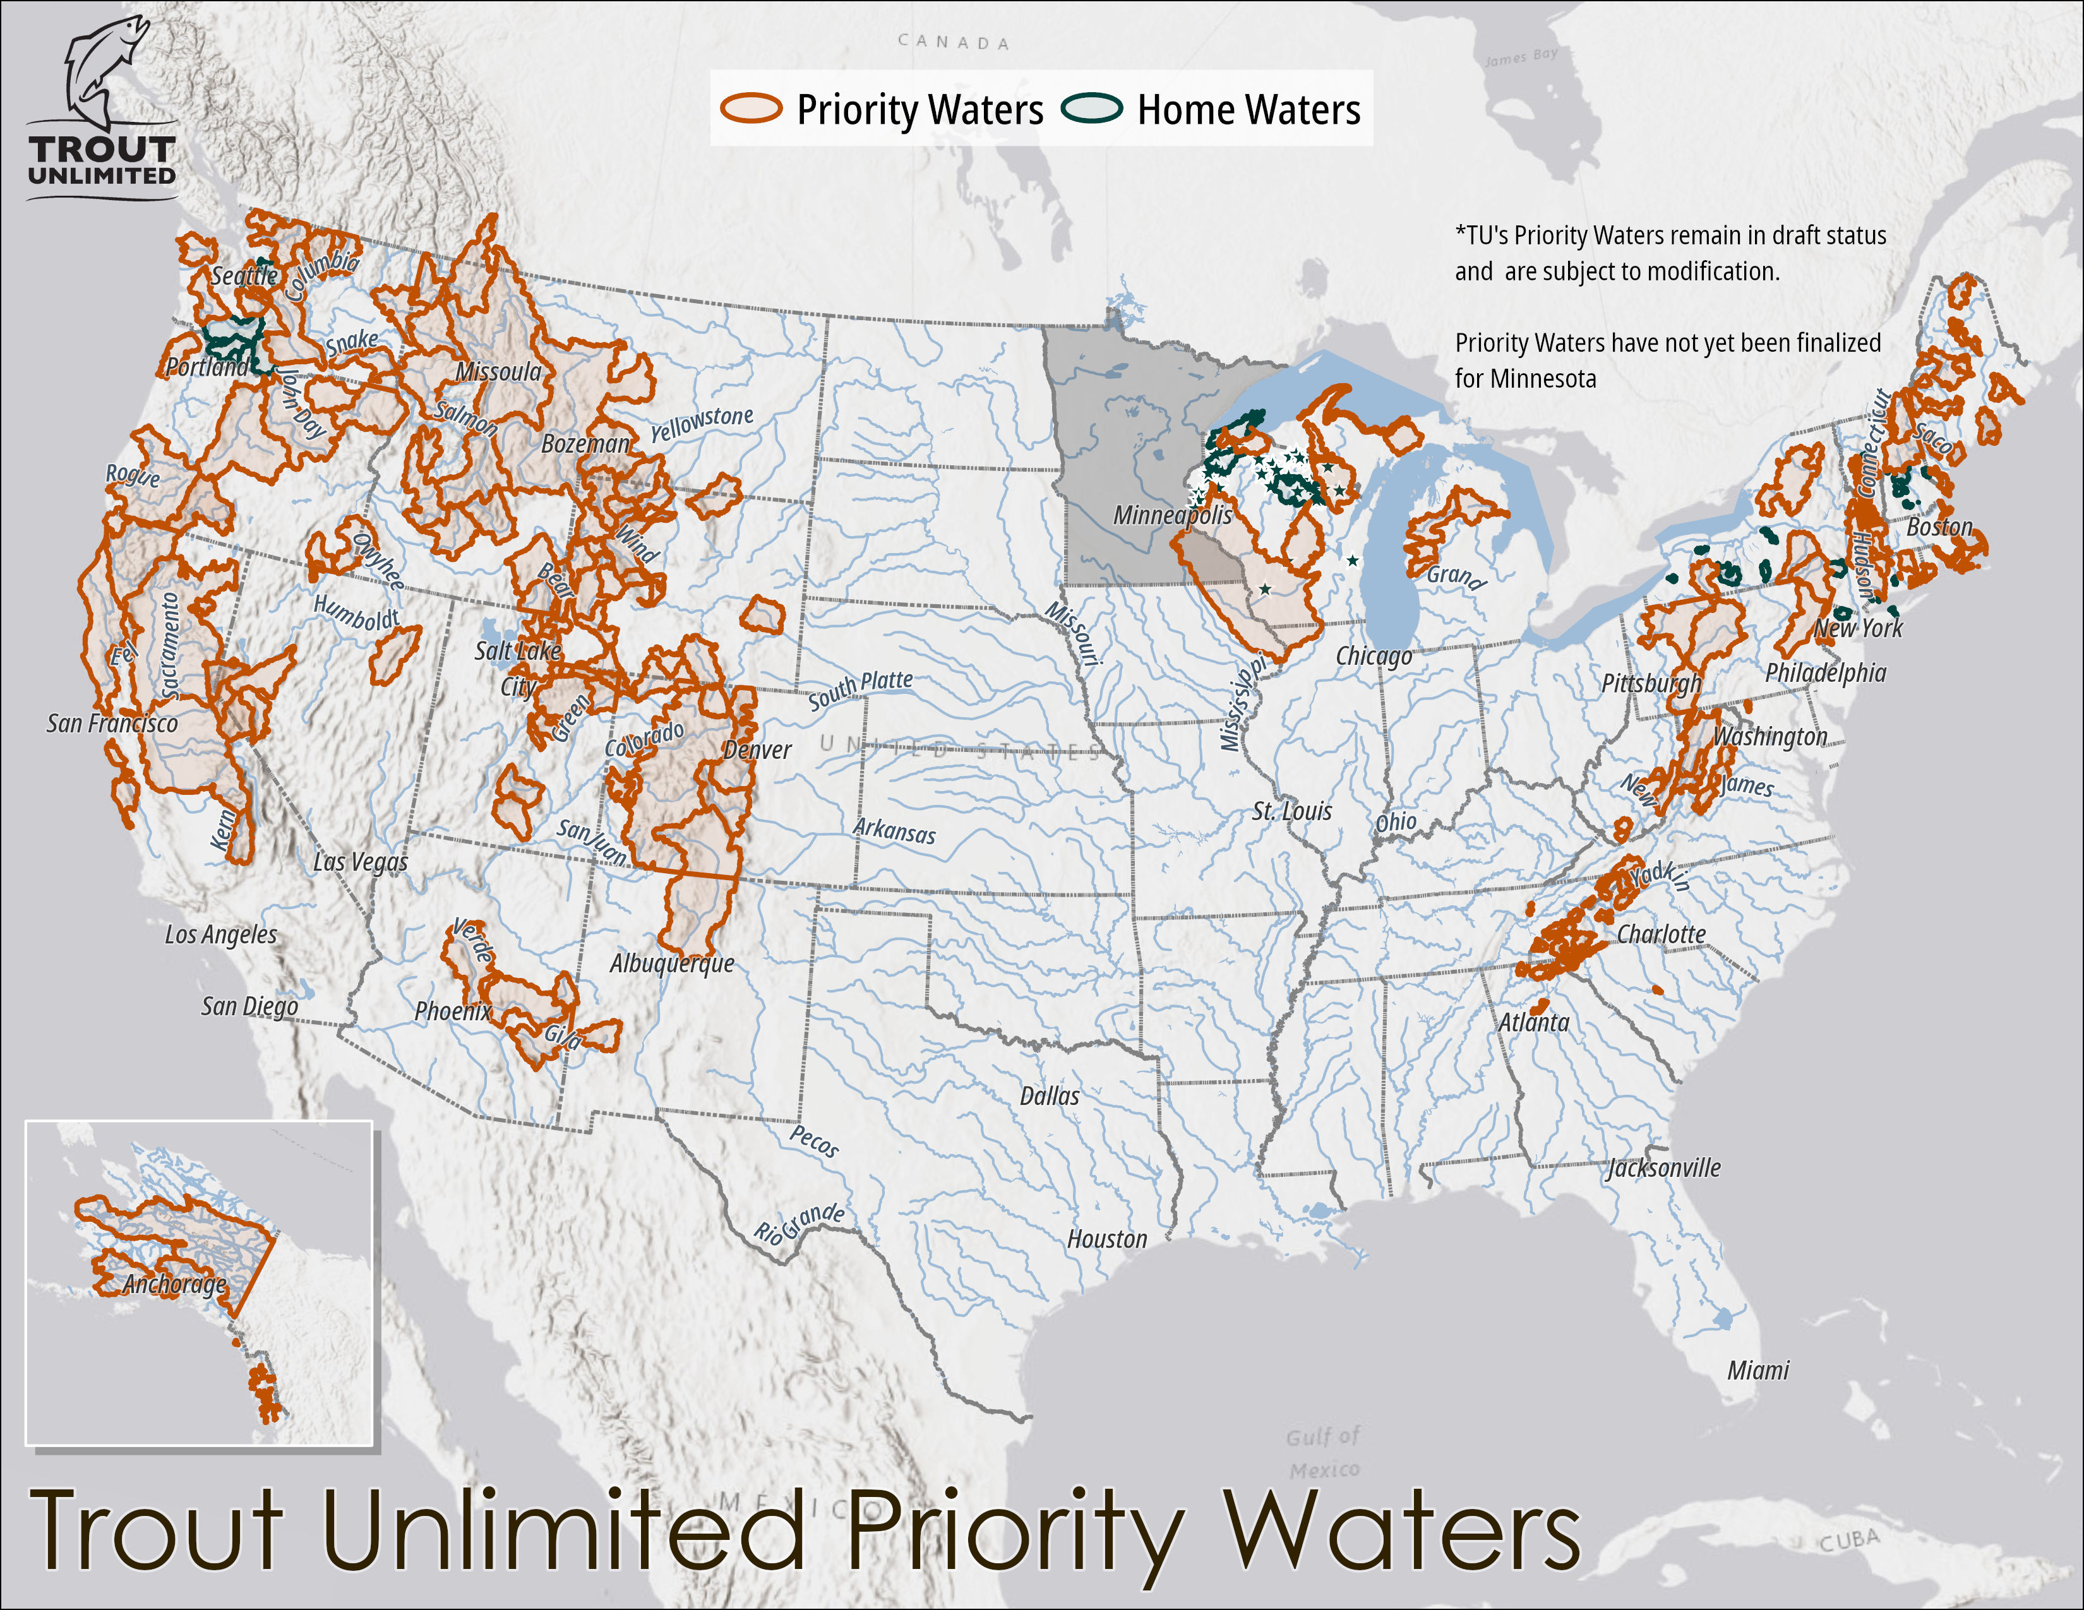
Where We Work
Our work is guided by science, supported by our network of volunteers and advocates, and uses high-leverage funding mechanisms to complete cutting-edge river restoration and reconnection projects.
To focus our efforts strategically on the most important habitat, we recently completed a comprehensive, state-by-state assessment to identify TU’s Priority Waters.
These are the places of greatest opportunity, where we have the strongest potential to protect, restore, or conserve trout and salmon fisheries.

Slide 7
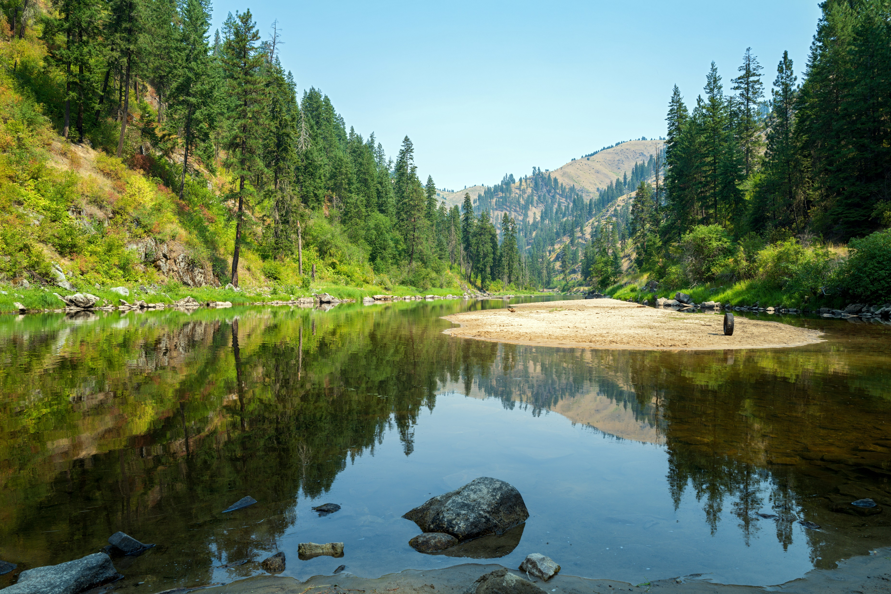
We Deliver On-the-Ground Results
PROTECTED
Over 10 Million acres of watershed landscapes and
9,278 MILES of rivers & streams
SUSTAINING THIS WORK IN OUR COMMUNITIES
Trout Unlimited’s 400+ chapters and councils connected our communities to:
RESTORED
467 MILES of rivers & streams
and 301 ACRES of habitat
OUR IMPACT IN 2023
• 630,931 volunteer hours valued at $20,063,606 invested in projects
• 3,217 conservation or science/monitoring projects involving 17,471 volunteers
• 3,185 youth activities that engaged 106,972 young people
• 4,624 community engagement activities reached 112,318 attendees
RECONNECTED
692 MILES of rivers & streams

Slide 8
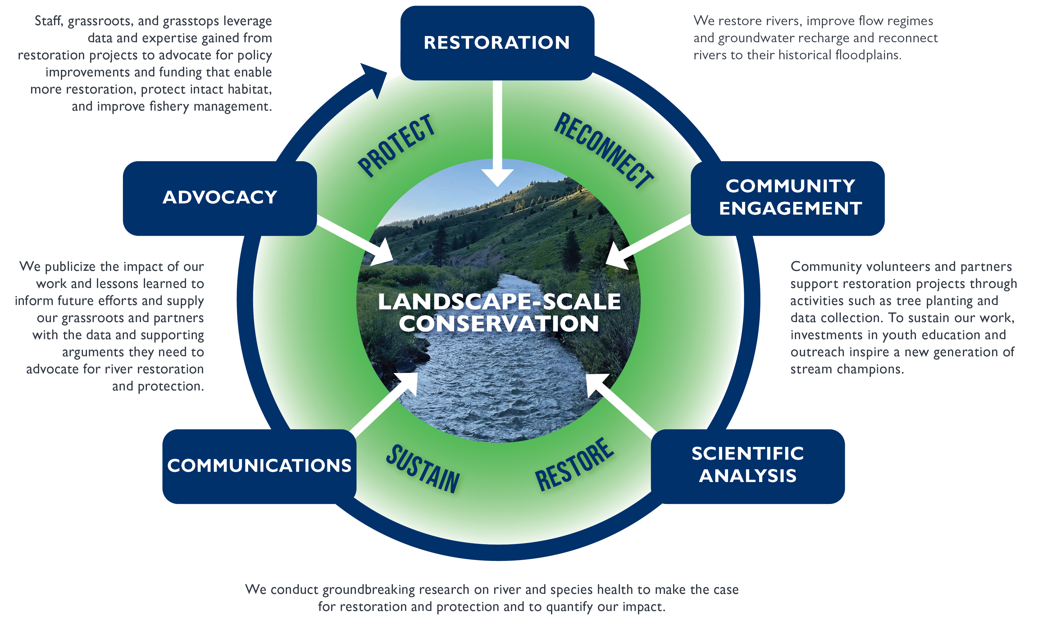
We Drive Effective Landscape-Scale Conservation

Slide 9
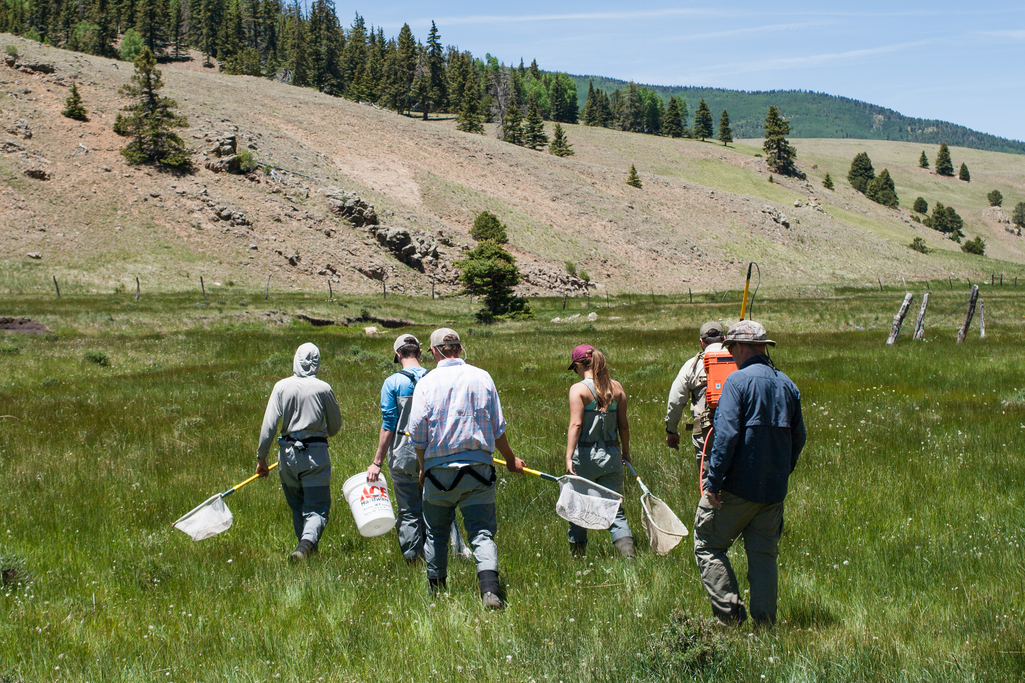

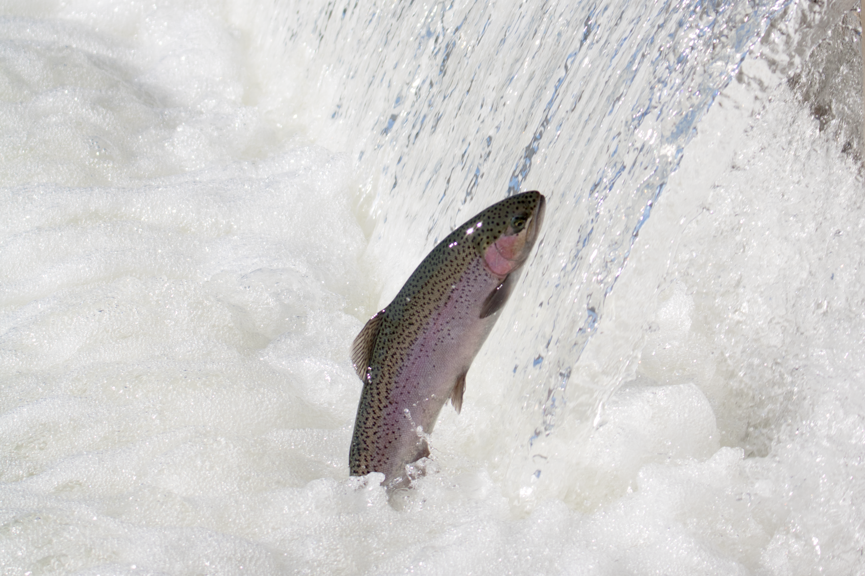
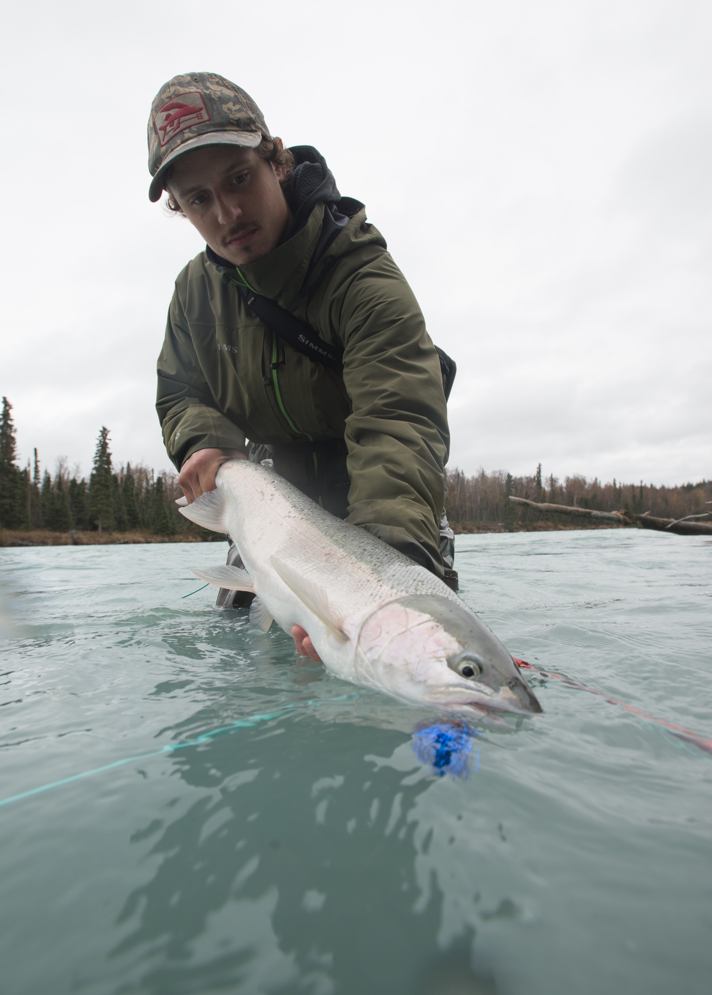
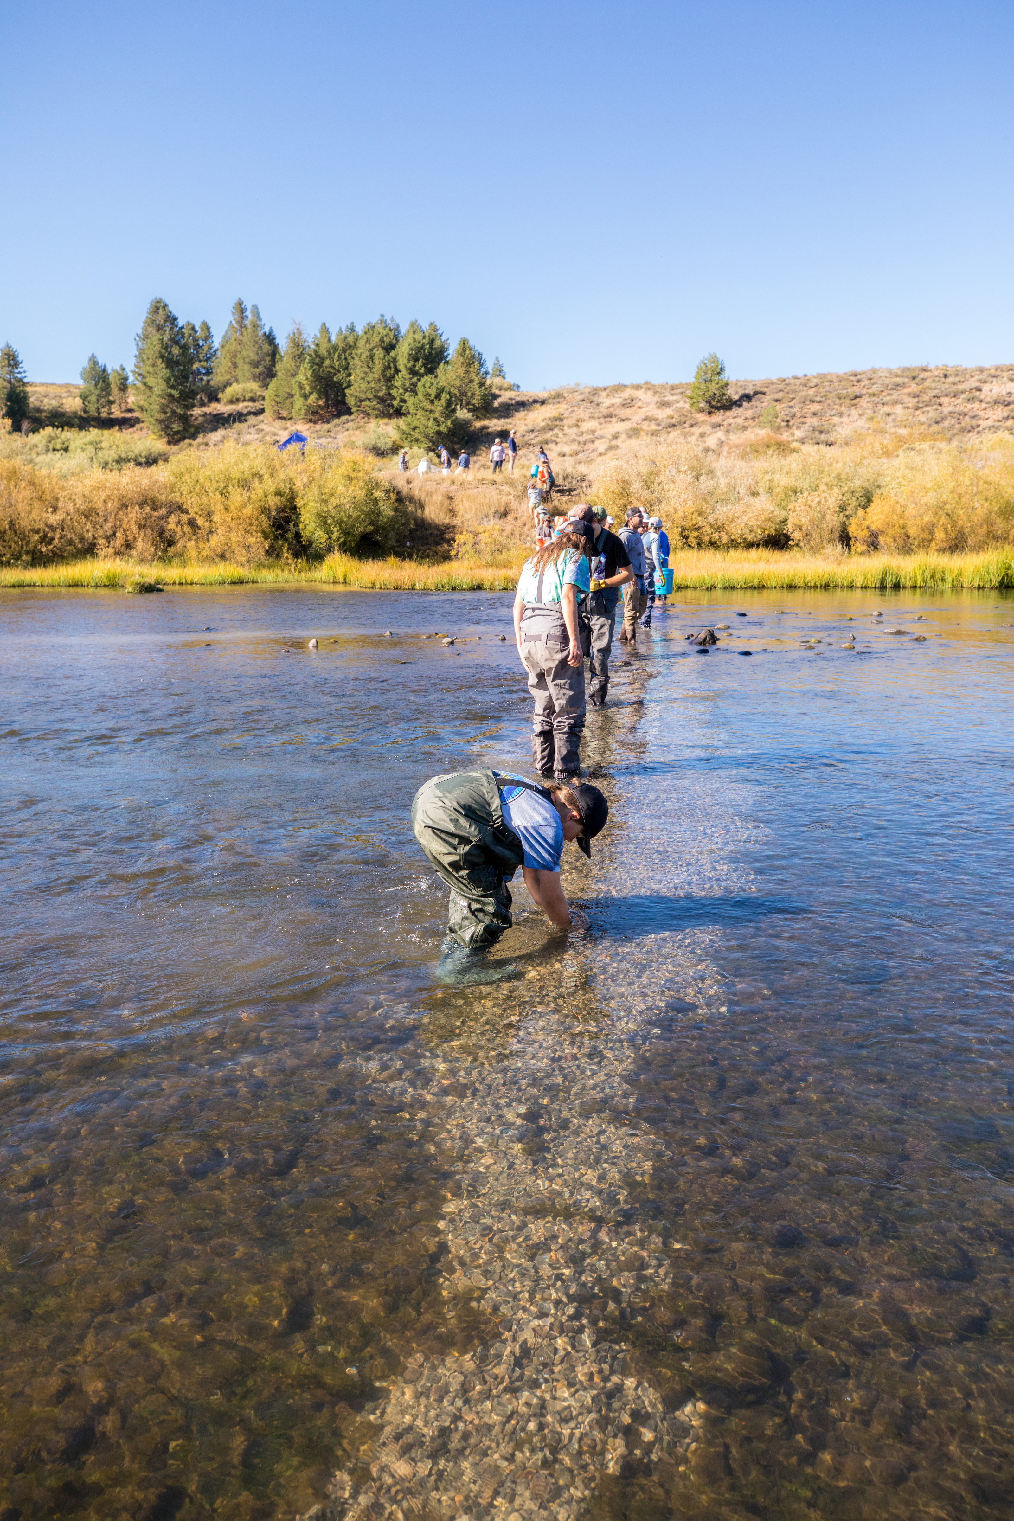
350,000
MEMBERS &
SUPPORTERS
400+
CHAPTERS
NATIONAL
STAFF OF 300+
ONE TU
33
BOARD TRUSTEES
36
STATE
COUNCILS
38 NATIONAL LEADERSHIP COUNCIL REPS & 12 WORK GROUPS

Slide 10
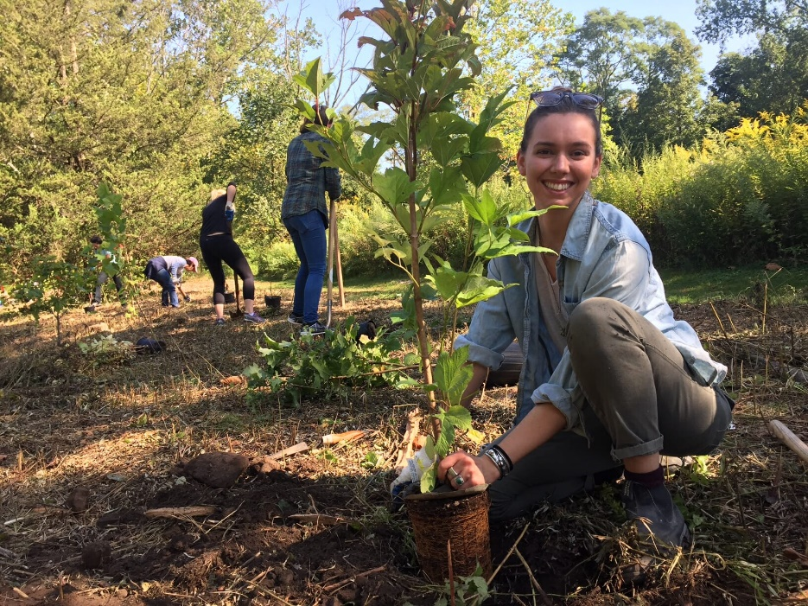

Impact: Chapter & Council Engagement in FY24
  630,931 total volunteer hours
  Raised and spent $16 million dollars locally
  11,753 events & activities, including:
    4,624 community engagement events
    3,217 conservation & science projects
    3,185 youth education activities
    727 veterans and first responder events
  245,897 event participants, including:
    106,972 young people
    5,196 veterans and first responders
    3,940 individuals from underserved communities
In the last year, volunteers planted 46,487 trees at 97 sites in 14 states, restoring 845 acres.
Notes:
I say it a lot, and I’ll say it again. We are the envy of our peers. Look at those tree planting numbers. Or consider that our volunteer hours are the equivalent of 303 full time staff. I share this to remind us that our chapter model remains the heart of how we engage folks locally. This is critical and will remain a central focus to our work.
630,931 volunteer hours. (11 percent growth over last year)
Total volunteer hours valued at $20,063,606, using the Independent Sector’s value of vol. time at $31.80/ hour.
The equivalent of 303 full time employees.
3,217 conservation or science/monitoring projects involving 17,471 volunteers. (5 percent growth over last year)
3,185 youth activities that engaged 106,972 young people. (2 percent growth over last year)
4,624 other general community engagement activities reached 112,318 attendees. (7 percent growth over last year)

Slide 11
FY24 The Average Chapter/ Council
 | Chapters | Councils
Less than $25k in Revenue | 246 | 18
$25k - $50k in Revenue | 59 | 3
$50K - $100K+ in Revenue | 21 | 3
$100K+ in Revenue | 18 | 9
Median Total Revenue | $12,210 | $21,239
Median Volunteer Hours | 983 | 1265
Notes:
11 chapters and one council didn’t file
4 chapters pending, one council pending.
Note, I did this work on the 16th (day after the deadline) and it doesn’t capture the 15 late filers.
368 chapters (One is in the process of decharter/ recharter – so if counts are off here from elsewhere, that’s why.)
35 councils
GRTU is counted as a chapter for these purposes.
The chapters that reported $100K+ in revenue accounted for $4.42 million. The chapters that reported over $100K+ in revenue accounted for $3.4 million.

Slide 12
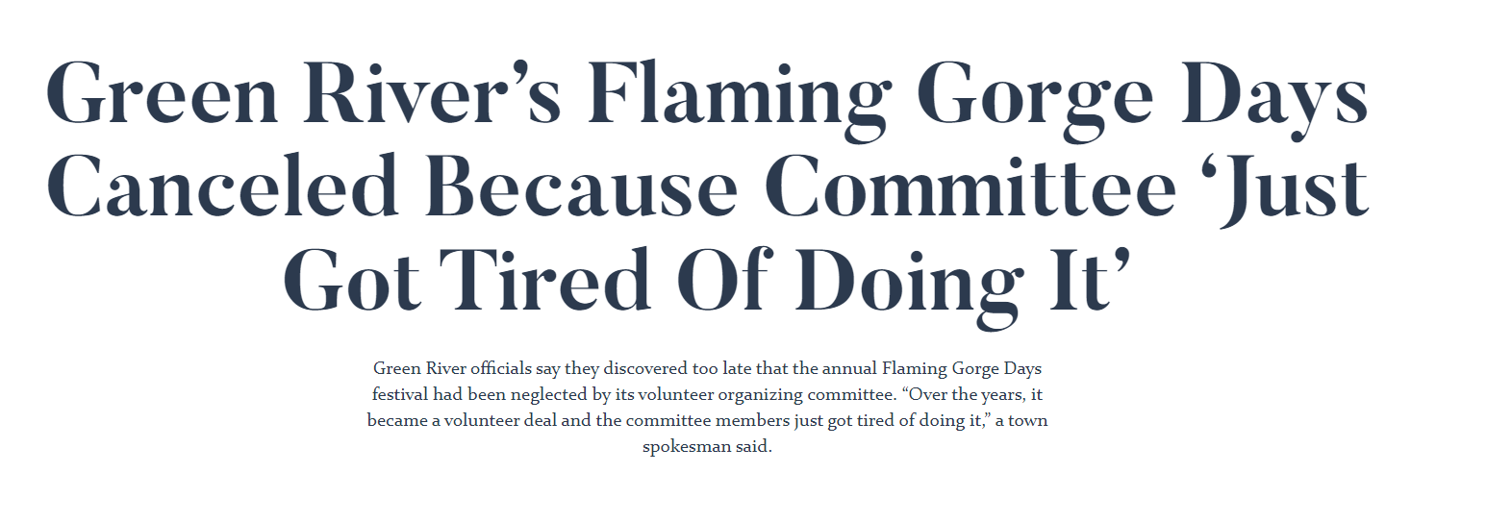
DON’T DO THIS!

Slide 13

The quality and bench depth of leadership is one of the key factors in predicting the long-term success and sustainability of a
TU chapter or council.

Slide 14

Good Governance Practices
Understand the basics of Robert’s Rules of Order
Read your bylaws
Have someone NOT on the bank account review the financials
Understand your insurance coverage
Bring this info back to your chapter!

Slide 15
Meetings vs. 0utreach activities
*18 month filing
COVID-19
Notes:
4,328 community engagement activities reached 87,451 attendees
2,796 meetings

Slide 16
Conservation, science and/or monitoring projects
COVID-19
*18 month filing
Notes:
We continue to hear in surveys, focus groups and most recently through the Prop Fuel tests… overwhelmingly folks want to engage with TU locally to “get their hands dirty and waders wet.” TU chapters provided those opportunities in spades with 3,217 conservation or science/monitoring projects involving 16,536 volunteers last year.
What is this trend happening? Some of this is just that this is the trend we have continued to see – an increase in volunteerism at TU. COVID pivots successful. Some of it is that we now have considerably more staff in the field, and many of them are effectively engaging local chapter and council leaders (and others outside of the chapter/ council model, which I will elaborate on in some examples later – though, notably, they wouldn’t be reflected in this data.) I’m going to spend a fair amount of the rest of my time today talking about this new dynamic and how we’re leveraging field staff for engagement.
But, before I pivot from traditional chapter engagement, I can’t help but share a run of the mill story that crossed my desk this week from the Chestnut Ridge chapter, pictured here at one of their kids fishing days. (Note the kids with the funny faces.)
Quentin Collins got a call from Ben Moyer, the tall guy in the photo who identified as the Chapter President of the Chestnut Ridge chapter of TU in super remote southwestern Pennsylvania. Q is chatting me while on the phone, “ever heard of this chapter?” Neither of us had any recall nor were we familiar with Ben. An hour and a half later, Q calls me and the first thing he says is, “I’m so motivated. This guy represents why I work here.” Q, who is about five years out of law school, goes on to tell me that Ben and the chapter have been hard at work since the mid-90s, before he was born, restoring Glade Run – a stream that when they started had no bug life, much less trout, largely due to mining waste. Silently and persistently, they just kept at it – involving partners, community science and even youth engagement – these kids planted trees there. Their persistence paid off. Brook trout are back and the state of PA declared the watershed of “exceptional value,” rendering it the highest available protections, and cited the good work of CRTU in its determination. The reason Ben called Q is that they received a $60,000 gift and they wanted to ensure they were following the gift acceptance policy and weren’t jeopardizing their tax status, a problem they resolved quickly. The hour and a half call was mostly just to share stories about how the chapter engaged the community in this success story. Q and I questioned how we had never heard this story before. We said in jest, though maybe with some truth, “he doesn’t complain.” He’s just a typical TU volunteer – he put his head down and brought his community together to solve a problem. A typical TU volunteer.

Slide 17
Identifying Leadership Needs
What is the vision for your chapter or council in the next 3-5 years?
What goals can you set for your chapter based on the new strategic plan?
What are the specific tasks that need to be accomplished to achieve these goals?
What skill sets do these tasks require?
What are the gaps in your current leadership team based on the skills needed?

Slide 18
Building A Community
RIVER CLEANUPS
ROAD SHOW
FILM TOURS
BAR
FLIES
FLY TYING
COMMUNITY
FISHING TRIPS
RESTORE RIVERS
ANGLER SCIENCE
YOUTH ED
CHAPTER MEETINGS
FLY FISHING CLASS
ADVOCACY
BANQUET
PUBLIC EVENTS

Slide 19
3 Big Takeaways
Understand how to use the Leader’s Only Section
Refer to the Tacklebox, Leadership Manual, and Online Forum when you have questions
Know that the Volops Staff is here to help!

